Slide 1
Sentiment Analysis for Enhanced Customer Churn Prediction in E-commerce
Team No. 45
ID: 20101477
Name: Md. Sifat Mahmud
ID: 21301232
Name: Irfanul Haque
ST Name: Sabbir Hossain and Mehnaz Ara Fazal

Slide 2
Implementation
Model Training & Validation:
Split data: Training to learn, validation to test.
Cross-validation: Ensures generalizability (K-Fold, Stratified).
Train models: Each methodology optimized for churn prediction.
Evaluation:
Metrics: Accuracy, precision, recall, F1, ROC-AUC.
Visualization: Confusion matrices & ROC curves for insights.
Integration:
Combine sentiment scores with features.
Identify top predictors for churn.

Slide 3
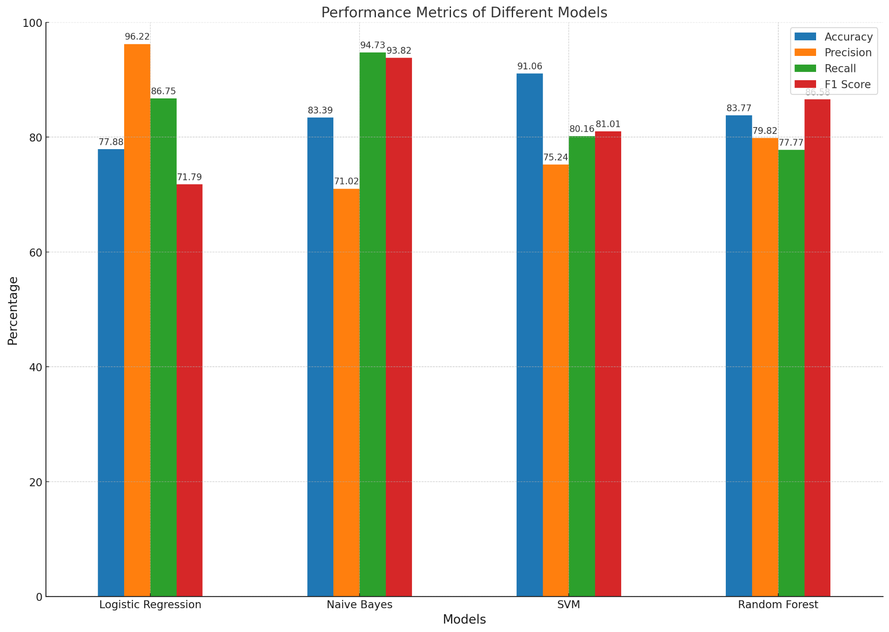
Result Analysis
Top Performer: Logistic Regression (96.22% Precision, 98.52% AUC).
Other Models:
Naive Bayes: High recall (94.73%) but lower precision (71.02%) and AUC (70%)
SVM: Good balance (91.06% accuracy) but average Precision (75.24%). and AUC (74.32%)
Random Forest: Decent overall (83.77% accuracy) and high discriminatory power (92.59% AUC).

Slide 4
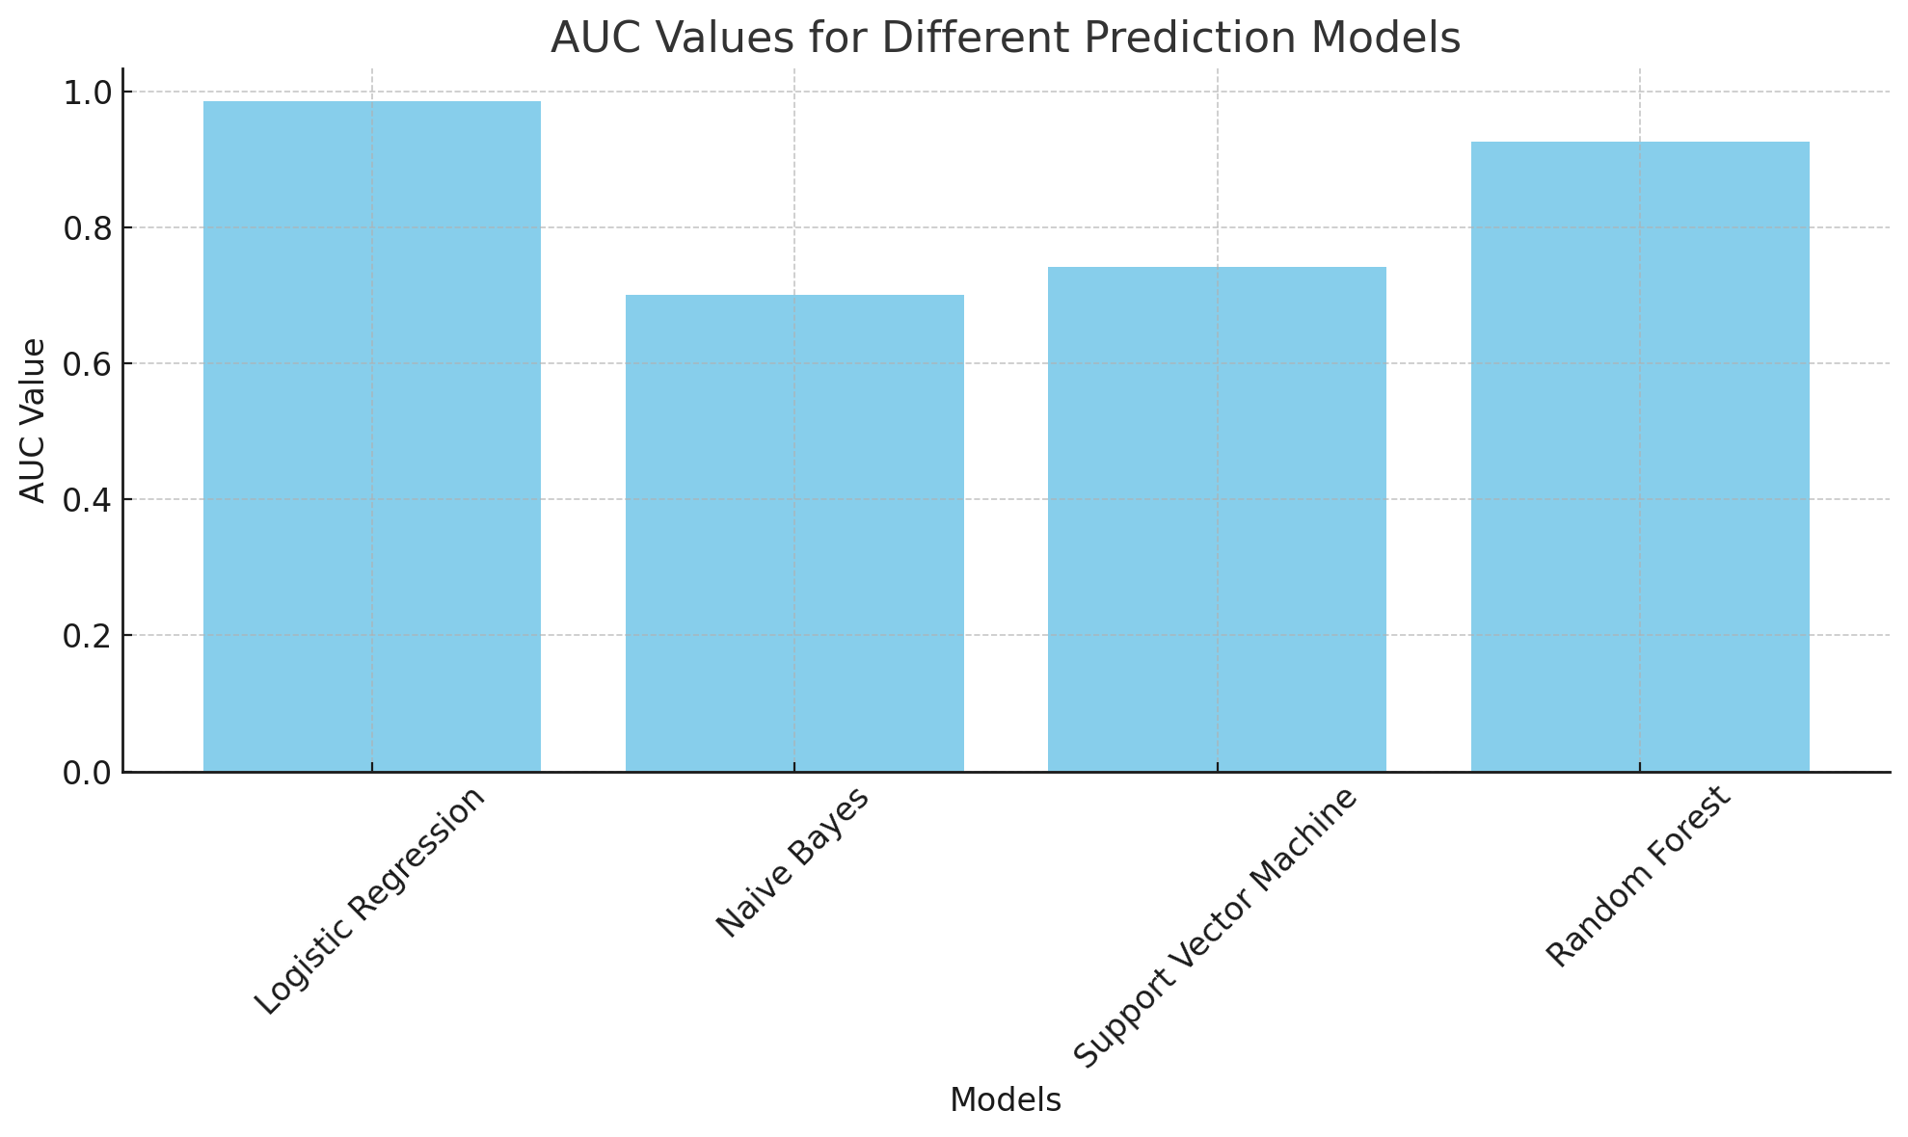
Result Analysis
Why Logistic Regression?
-Highest AUC - best at differentiating churners vs. non-churners.

Slide 5
Limitations
Sentiment Analysis Method: Future research could explore more advanced NLP methods.
Model Generalizability: The current models are tailored for the dataset used and may not apply universally to all e-commerce scenarios.
Feature Selection: Certain influential factors, such as customer service interactions or website navigation experience, were not included. Future models could incorporate a broader range of features.

Slide 6
Future Works:
Advanced Sentiment Analysis Techniques: Utilizing deep learning and AI to achieve a more accurate and nuanced understanding of customer sentiments.
Hybrid Predictive Models: Developing models that combine various machine learning techniques to improve accuracy and reliability.
Comprehensive Customer Journey Analysis: Expanding the model to include various stages of the customer journey for a holistic churn prediction.
Economic Impact Assessment: Evaluating the cost-benefit of implementing these models in real-world settings, considering both the expenses and potential gains.

Slide 7
Conclusion
Sentiment analysis boosts churn prediction: All models improved with sentiment data, highlighting the power of understanding customer emotions.
Logistic Regression shines: Highest Area Under the Curve (AUC) of 98.52%, making it the best at differentiating churners from non-churners.

